Slide 1




2025
The Code Behind Creativity
Designing Smart: Creativity with your Phone
Page 1
Presented by
VICTOR A.I
Next Slide

Slide 2
2025
Welcome & quick self-introduction
Brief story of my journey as a designer (from mobile design to professional)
“Creativity is not for a few, it's in all of us. You just need to decode it.”
Page 2
Next Slide
Presented by
VICTOR A.I

Slide 3

2025
Why Creativity Matters
Creativity = problem-solving + expression + value creation.
You don’t create to impress, you create to express what’s inside.
The more problems you solve, the more valuable you become.”
Page 3
Next Slide
Presented by
VICTOR A.I

Slide 4
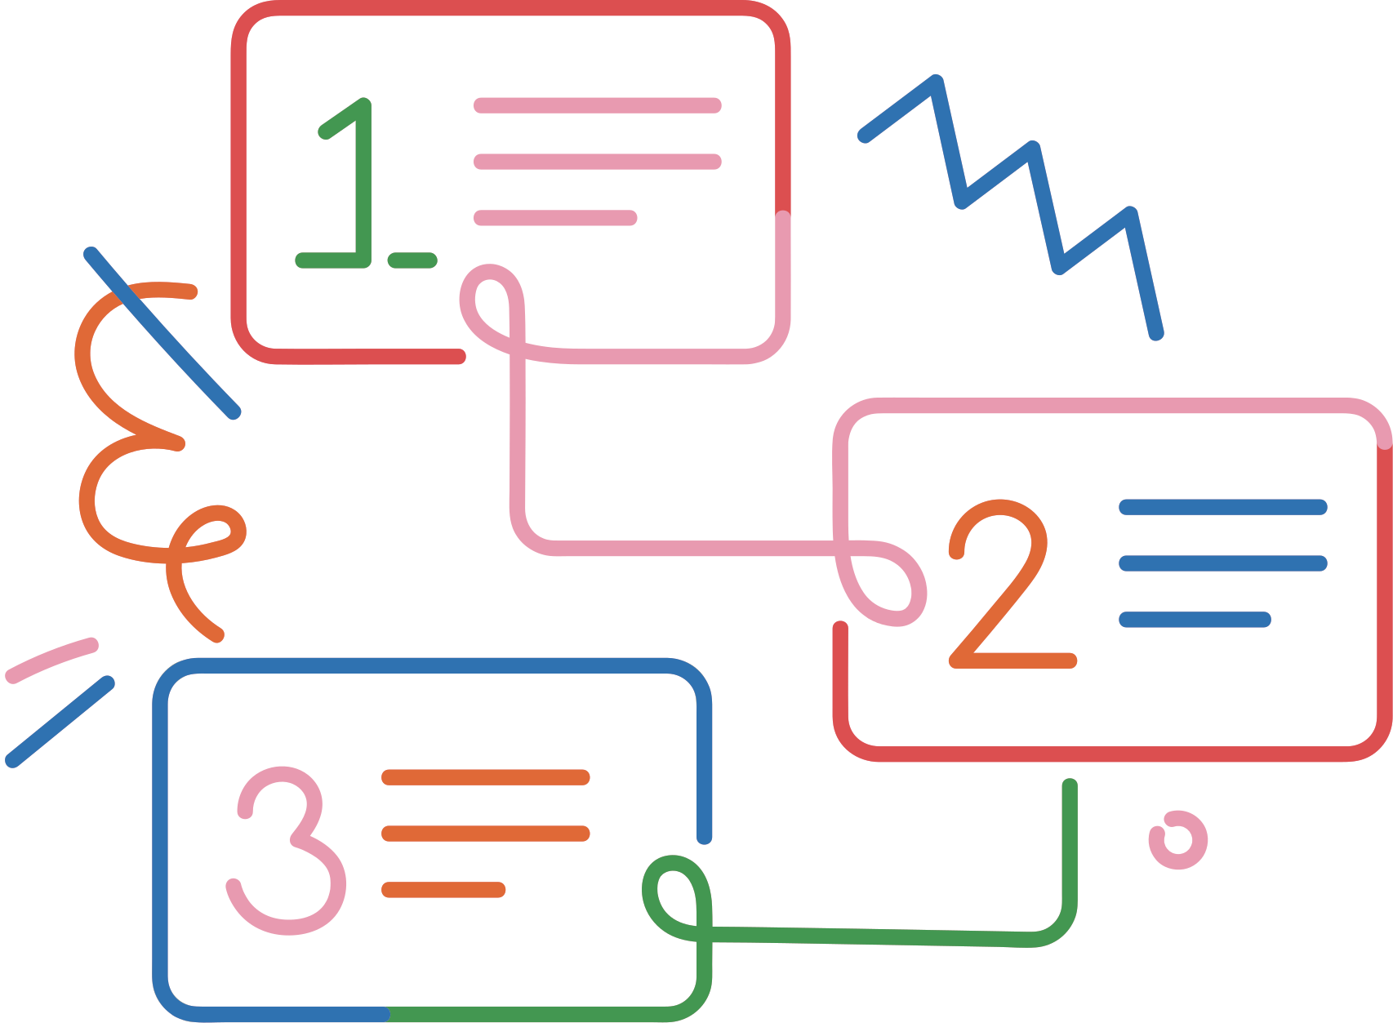
2025
Understanding the Code
Creativity is a Process, Not a Mystery
1. Curiosity: ask questions.
2. Observation: see what others don’t.
3. Consistency: keep practicing
Page 4
Next Slide
Presented by
VICTOR A.I

Slide 5
2025
What is Graphic Design?
Graphic design is the art and practice of creating visual content to communicate ideas, messages, or information. It combines images, text, colors, and layouts to make communication both appealing and effective.
Page 5
Next Slide
Presented by
VICTOR A.I

Slide 6

2025
The Designer’s Growth Path
“Design is growth not competition.”
1. Learn: free tutorials & courses.
2. Practice: daily challenges.
3. Build: create your portfolio.
4. Network: join communities.
5. Earn: start freelancing.
Page 6
Next Slide
Presented by
VICTOR A.I

Slide 7
2025
The Power of Mobile Graphics
If all you have is your phone, start with it.
Don’t wait for perfect tools — create with what’s in your hands.” (Exodus 4:2)
Page 7
Next Slide
Presented by
VICTOR A.I

Slide 8



Slide 9
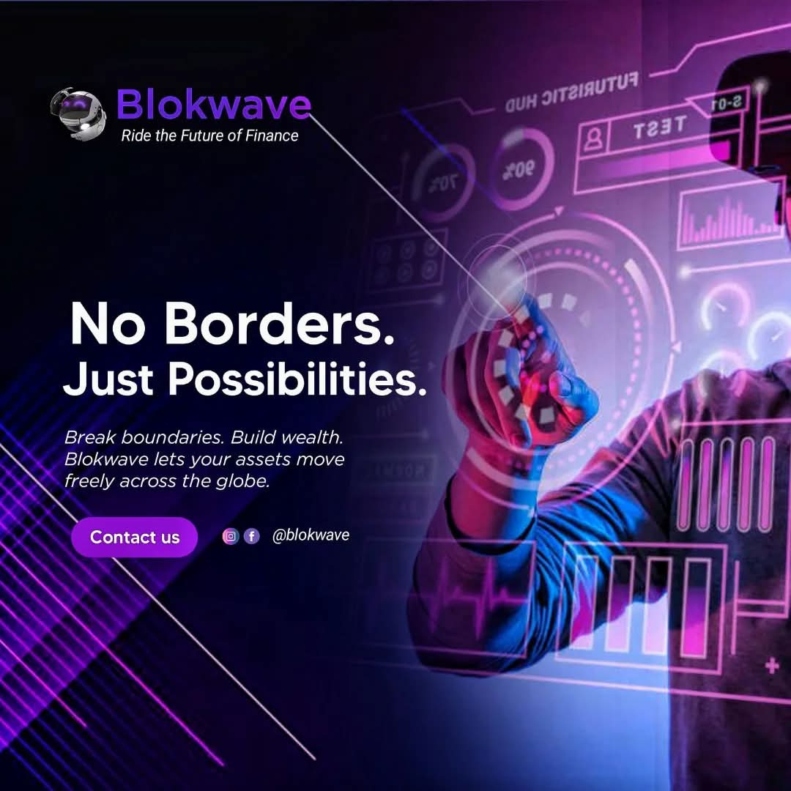
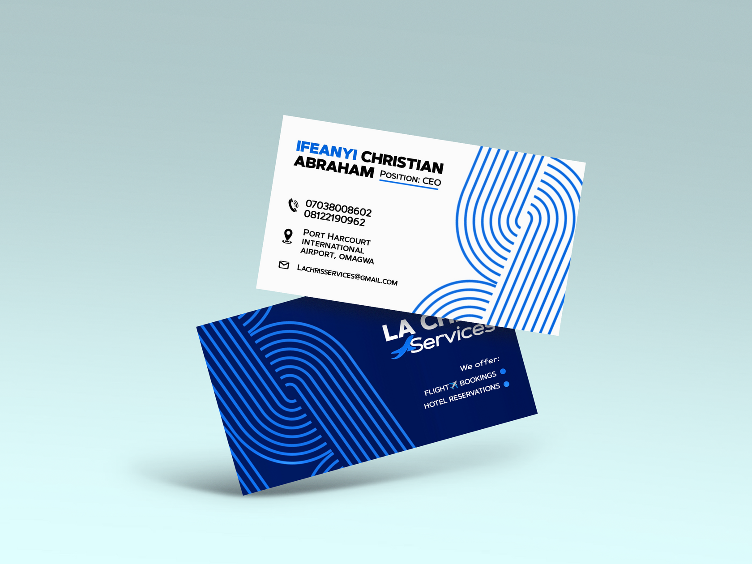

Slide 10

2025
Tools for Smart Design
• Photo Room: Removes Background, Photo Manipulation
• Photo Light or Remini: (Enhance Photos)
• Snapseed: Photo Editing, Design Enhancement, Background Manipulation etc.
• Canva
• Pixellab YD
Page 10
Next Slide
Presented by
VICTOR A.I

Slide 11

2025
Common Challenges
• Self-doubt
• Low pricing
• Lack of inspiration
• Comparison on social media
• Difficult Client
Page 11
Next Slide
Presented by
VICTOR A.I

Slide 12
2025
DEMO TIME
Hands-on: Designing on Mobile (Pixellab)
Page 12
Next Slide
Presented by
VICTOR A.I

Slide 13
2025
Conclusion
You carry creative potential from God.
Start with your phone, build with excellence.
Let your creativity serve purpose and people.
Your creativity can serve both God and men.
Page 13
Next Slide
Presented by
VICTOR A.I

Slide 14
2025
Q&A + Interaction
Page 14
Next Slide
Presented by
VICTOR A.I

Slide 15
2025
Thank you
Page 15
Next Slide
Presented by
VICTOR A.I

